Slide 1

Databases
Session 2
Sandra Pico Oristrell
December 2023

Slide 2
Agenda
Part 1: Theory (1h:15 min)
Introduction to Databases in AWS
Introduction to Amazon RDS
Introduction to Amazon DynamoDB (Key-value pair database)
Introduction to Graph Databases and Amazon Neptune
Resources
Break (15 min)
(45 min) Use case: Building a Knowledge Graph with Amazon Neptune
Part 2: Hands-on (45min)
AWS Educate: Getting Started with Databases
AWS Educate: Builder Labs (Adding Dynamic Data to your Application with DynamoDB)

Slide 3
Part 1: Theory

Slide 4
Big Data on AWS
Session 2: Databases
Data Sources
Data Storage
Batch Processing
Analytics Storage
Reporting
Machine Learning
Real-time Ingestion
Streaming processing

Slide 5
Introduction to Databases in AWS

Slide 6
Why databases?
A database is a logically organized collection of information, designed in such a way that the information within can be accessed for later use by a computer program. Databases give access to the data while keeping the integrity of the data in a secure environment.
A data model is the logical structure of a database and determined the rules for how information can be organized and used. The data models you choose is influenced by the structure of your data: structured, unstructured and semi structured.
Structured data
Unstructured data
Semi-structured data

Slide 7
Data types
Structured data
Stored as a series of data values in related tables.
Highly structured
Formatted so the elements can be made addressable for more effective processing and analysis
Data able to be used in highly complex queries.
SKU | Color | Amount | OrderDate
XYZ | Blue | 200 | 07-2022
ABC | Orange | 500 | 08-2022

Slide 8




Data types
Unstructured data
Stored as files
Lacks predefined structured
Special tools to catalog and query
Examples: images, audio, video, word processing files…

Slide 9
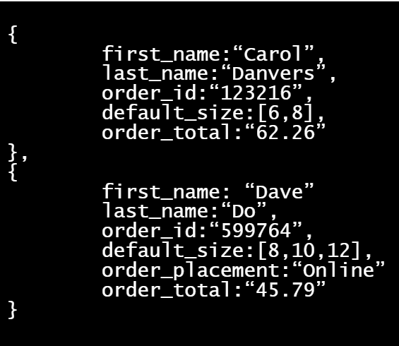
Data types
Semi-structured data
Highly flexible because the structure is not strict and can be
changed as needed within the table.
Semi structured data can be analyzed but not with the same
level of complexity that analytics on structured data can achieve.

Slide 10
Relational and non-relational database
Relational database
Non-relational database (No-SQL database)
Relational database
Relational database
Structured data
Unstructured data
Semi-structured data

Slide 11
Database terms and concepts
1
Schema
A database schema is the blueprint of the database. The schema outlines the relationships within the database and the constraints of the database.
2
IOPS
Input/output operation per second (IOPS) is the measure of performance of reads and writes to a storage location like a database.
To improve latency and read/write throughput, provision more IOPS when configuring the database. Limiting the IOPS may cause the database to hit the threshold and reduce performance. Over provisioning of IOPS will result in higher costs for the instance.

Slide 12
Database terms and concepts
3
ACID and BASE compliance
Transactions are groups of statements or operations that take place in a database. Issues arise when tow sessions try to change the same record or item at the same time. Transactional compliance includes methods for maintaining consistency and integrity in a database.
ACID (Atomicity, consistency, isolation and durability) is used in structured database. One goal of an ACID compliant database is to return the most recent version of all data. It also must ensure that data entered the system always meets all assigned rules and constraints.
BASE compliance is used in a non-relational database. BASE supports data integrity in non-relational databases.

Slide 13
Database terms and concepts
3
ACID and BASE compliance
ACID
BASE
Atomicity: When completing a transaction, atomicity ensures that your transactions either completely succeed or completely fail.
Consistency: Ensures that all transactions provide valid data to the database. Ensures that data updates are not made available until all replicas have been updated as well.
Isolation: Isolation ensures that one transaction cannot interfere with another current transaction.
Durability: Making sure your data changes stick.
Basically Available (BA): Allows for one instance to receive a change request and make that change available immediately. In an ACID system the change does not become available until all instances are consistent. Consistency in a BASE model is traded for availability.
Soft state: There are allowance for partial consistency across distributed instances. In an ACID system, the database is in a hard state because users cannot access data that is not fully consistent.
Eventually consistent: The data will eventually be consistent. The change will eventually be made to every copy. However, the data will be available in whatever state it is during propagation of the change.

Slide 14
Database terms and concepts
4
OLTP/OLAP
The structure of relational tables is great for transactional data and data that may require highly complex join operations when queried. There are two methods for organizing information: OLTP (Online Transaction Processing) or OLAP (Online analytical processing).
OLTP databases focus on recording Update, Insertion and Deletion data transactions. OLTP queries are simple and short, which require less time and space to process. Example: Bank ATM, in which you can modify your bank account using short transactions.
OLAP databases store historical data that has been input by OLTP. OLAP databases allow users to view different summaries of multidimensional data. A good example of OLAP system is a business intelligence tool which ingest business data and presents user-friendly views such as reports, dashboards and graphs.

Slide 15
Relational and non-relational database
Relational database
A relational database is a collection of data records organized as a set of tables with rows and columns. Each row holds information about a record, and the columns contain attributes of the data. Each row has an identifier column to uniquely distinguish the record from other records. The value of the identifier column is called a primary key. Other tables can reference a primary key. A record in another table that references a primary key is called a foreign key.
Course_ID | Title | Status
1113 | Getting Started with Databases | 200
1114 | Getting Started with Cloud | 500
Primary key
Book_ID | Book Title | Course ID
24221 | Introduction to SQL | 1113
24122 | Introduction to IAM | 1114
Ins_ID | Book Title | Course ID
8977 | Marta Gonzalez | 1113
8978 | Joan Serra | 1114
Foreign key

Slide 16
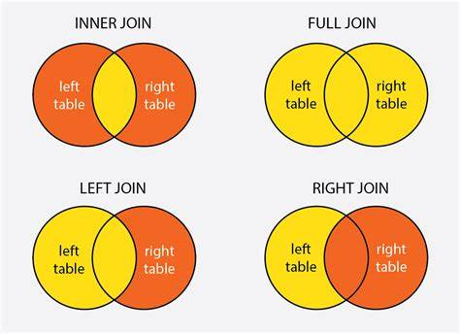
Relational and non-relational database
Relational database: Structured Query Language (SQL)
What books do I need to buy to take each course?
SELECT * FROM TableA LEFT JOIN TableB ON TableA.Course_ID = TableB.Course_ID;
TableA
Course_ID | Title | Status
1113 | Getting Started with Databases | 200
1114 | Getting Started with Cloud | 500
Book_ID | Book Title | Course ID
24221 | Introduction to SQL | 1113
24122 | Introduction to IAM | 1114
Ins_ID | Book Title | Course ID
8977 | Marta Gonzalez | 1113
8978 | Joan Serra | 1114
TableB
TableC

Slide 17
Relational and non-relational database
Relational database: Structured Query Language (SQL)
What books do I need to buy to take each course?
SELECT * FROM TableA LEFT JOIN TableB ON TableA.Course_ID = TableB.Course_ID;
Course_ID | Title | Status
1113 | Getting Started with Databases | 200
1114 | Getting Started with Cloud | 500
Book_ID | Book Title
24221 | Introduction to SQL
24122 | Introduction to IAM

Slide 18
Relational and non-relational database
Non-relational database
A non-relational database stores data in unstructured ways using one of many storage models, including key-value pairs, documents and graphs. Non relational schemas are dynamic – i.e., a row does not have to contain data for each column.
Non-relational databases examples
Relational database
Key-value pair
Documents
Graph

Slide 19
Why AWS databases
Purpose built
Performance at scale
Fully managed
Secure and highly available

Slide 20
AWS Databases
Relational
Key-value
Document
In-memory
Graph
Timestream

Slide 21


AWS Databases
Relational
Key-value
Document
In-memory
Graph
Ledger
Amazon Relational Database Service (Amazon RDS)
Amazon Aurora

Slide 22

AWS Databases
Relational
Key-value
Document
In-memory
Graph
Ledger
Amazon DynamoDB

Slide 23

AWS Databases
Relational
Key-value
Document
In-memory
Graph
Ledger
Amazon DocumentDB (with MongoDB compatibility)

Slide 24

AWS Databases
Relational
Key-value
Document
Amazon ElastiCache
In-memory
Graph
Timestream

Slide 25

AWS Databases
Relational
Key-value
Document
Amazon Neptune
In-memory
Graph
Timestream

Slide 26

AWS Databases
Relational
Key-value
Document
Amazon Timestream
In-memory
Graph
Timestream

Slide 27
AWS Databases
Today’s session
Relational
Key-value
Graph
Amazon Relational Database Service (Amazon RDS)
Amazon DynamoDB
Amazon Neptune
Theory
AWS Educate: Lab 1
Theory
AWS Educate: Lab 2
Theory
Use case: AWS Blog post

Slide 28
Introduction to Amazon RDS

Slide 29
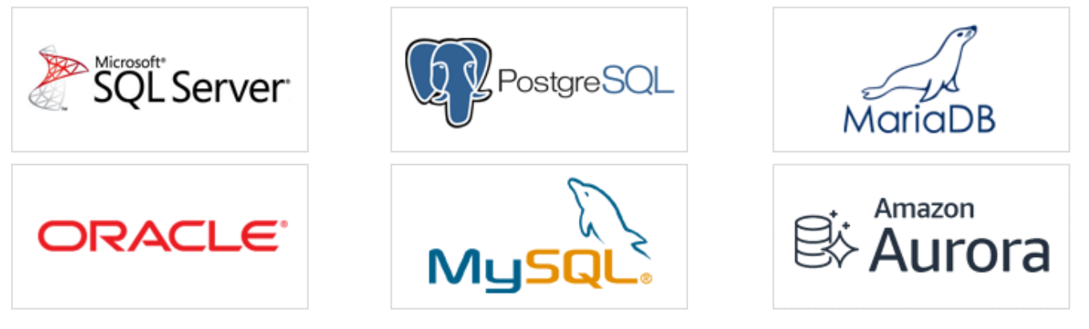
Amazon Relational Database Service (RDS)
Introduction to Amazon RDS
Amazon Relational Database Service (Amazon RDS) is a fully managed relational database in the cloud. It supports multiple database engines to suit the needs of most relational database use cases.
There is no need to provision infrastructure or to install and maintain database software.
There are 6 database engines to choose from

Slide 30
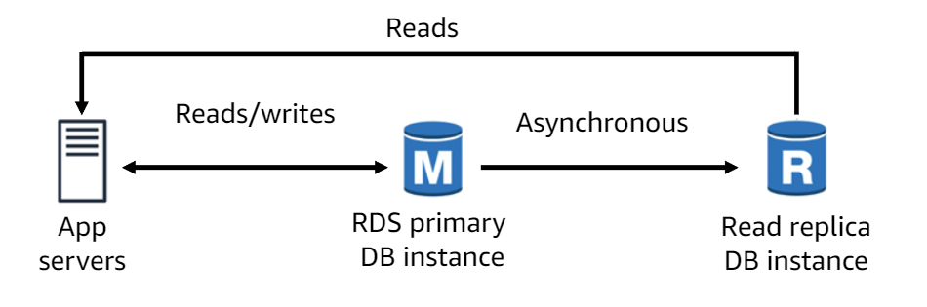
Amazon Relational Database Service (RDS)
Use cases for Amazon RDS
In this online transaction processing application (OLTP), Amazon RDS is used with a read replica which is asynchronously updated. Amazon RDS read replica make it easy to elastically scale out for read-heavy database workloads beyond the capacity constraints of a single database instance.
You can create one or more replicas of a given source database instance and serve high-volume application read traffic from multiple copies of your data, thereby increasing aggregate read throughput.

Slide 31
Introduction to Amazon DynamoDB

Slide 32
Amazon DynamoDB
Amazon DynamoDB is a fast, non-relational database service that makes cost-effective
to store data. It is a fully managed, multi-region, durable database with built-in security,
backup and restore, and in-memory caching for internet-scale applications.

Slide 33
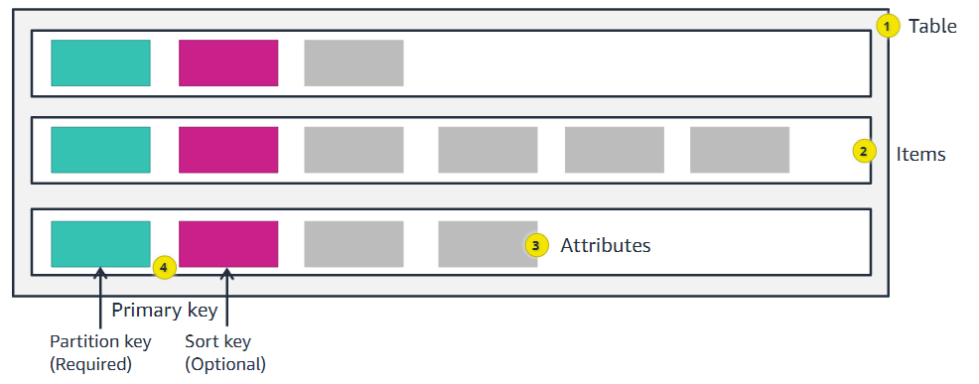
Amazon DynamoDB Components
A table is a collection of items, and each item is a collection of attributes.
DynamoDB tables do no have fixed schemas, and each item might have a different number of attributes.

Slide 34
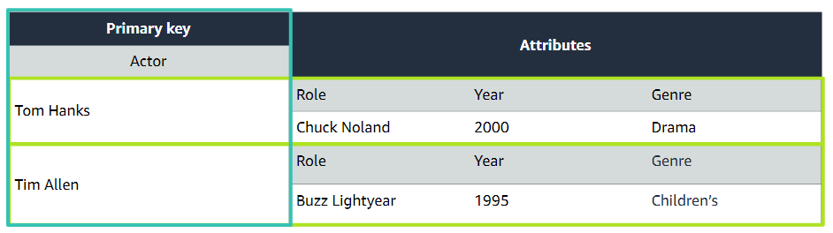
Amazon DynamoDB: Primary Key
Amazon DynamoDB uses primary keys to uniquely identify each item in a table and secondary indexes to provide more querying flexibility. Therefore, the primary key uniquely identifies each item in the table so that no two items can have the same key.

Slide 35
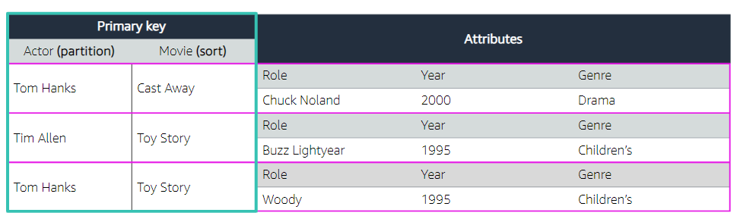
Amazon DynamoDB: Composite keys
Composite primary key (partition and sort key): A composite primary key consists of two attributes. The first attribute is the partition key, and the second attribute is the sort key.
The composite of the two keys must be unique across the entire table. The composite key must be unique.

Slide 36
Amazon DynamoDB consistency models
When reading data from DynamoDB, users can specify whether they want the read to be eventually consistent or strongly consistent.
Eventually consistent reads (the default) – The eventual consistency option maximizes your read throughput. However, an eventually consistent read might not reflect the results of a recently completed write. All copies of the data usually reach consistency within a second. Repeating the read after a short time should return the updated data.
Strongly consistent reads: In addition to eventual consistency DynamoDB also give you the flexibility and control to request a strong consistent read. A strongly consistent read returns a result that reflects all writes that received a successful response before the read.

Slide 37
Amazon DynamoDB: Read and Write capacity modes
Provisioned mode
On-demand mode
You have predictable application traffic.
You run applications whose traffic is consistent or ramps gradually.
You can forecast capacity requirements to control cost.
You create new tables with unknown workloads.
You have unpredictable application traffic.
You prefer the ease of paying for only what you use.

Slide 38
Introduction to Graph Databases
and Amazon Neptune

Slide 39


Graph Databases with Amazon Neptune
City: Barcelona
lives_in
Graphs model data based on relationships.
Graphs explore relationships and patterns in connected data.
Name: Alice
works_with
Name: Bob

Slide 40
Graph Databases with Amazon Neptune
Nodes
City: Barcelona
lives_in
Graphs model data based on relationships.
Graphs explore relationships and patterns in connected data.
Name: Alice
works_with
Name: Bob
Edges

Slide 41
Graph use cases
We need to get better at detecting fraud.
My customers want better or more personalized recommendations.
We need to connect our siloed data sources.
We have multiple websites/applications, and we need to link customer identities in these systems.
Our machine learning algorithms need improvement.
Fraud detection
Identity Graph
Knowledge Organization (Knowledge Graph)

Slide 42
Query Languages
Graph query languages are optimized to use connections to move through a network.
works_at
g.V().has(‘person’,’Dave’)
Dave
AWS
Person | Age
Dave | 30
Person | Company
Dave | AWS
Company | StartDate
AWS | 30/05/2021

Slide 43
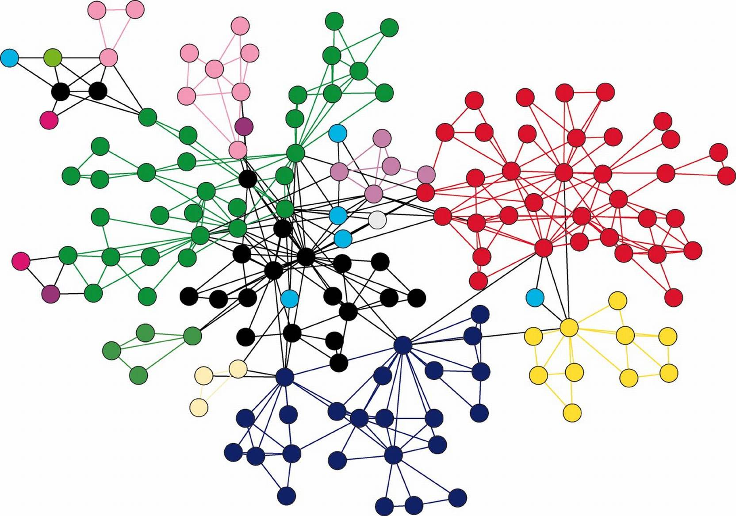
Schema flexibility
The schema flexibility makes adding new data sources easy.

Slide 44
Why use Amazon Neptune?
Traditional databases are not optimized for connections
Self-managed solutions become complex
Evolution at Scale

Slide 45
Why use Amazon Neptune?
Fully managed, purpose-built graph database in the cloud.
Optimized to store and map billions of relationships.
Enables real-time navigation of connections with millisecond query response time.
Supports open standard query languages openCypher, Gremlin and SPARQL.
Amazon Neptune
Cost effective
No hardware management
Instant provisioning
Scaling
Security and Compliance

Slide 46


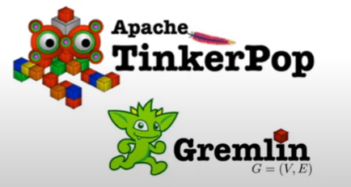
Leading graph models and languages
Property graph
Resource Description Framework (RDF)
(SQL-inspired)
Edges representing real world entities and edge representing connections.
Ability to associate properties to the nodes and to the edges themselves.
RDF represents data as a set of triples.
Each triple has subject, predicate and object.

Slide 47
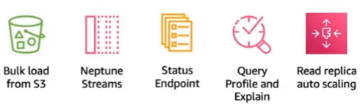
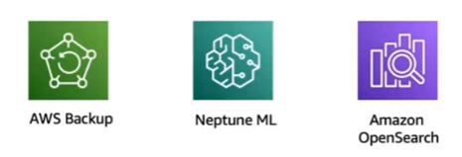
Amazon Neptune Architecture
Application Layer
Service Features
Fraud detection
Identity Graph
Knowledge Organization (Knowledge Graph)
Compute Layer
1 writer and up to 15 read replicas
Service Integrations
Shared Storage Layer
6 copies of data across 3AZs
Data up to 128TiB
Automated backup and restore
Database fast clone

Slide 48
Use case

Slide 49

Building a Knowledge Graph
Amazon Neptune
Building a knowledge graph in Amazon Neptune using Amazon Comprehend Events | AWS Database Blog
Announcing the launch of Amazon Comprehend Events | AWS Machine Learning Blog
Reading time
30 min
Discussion time
15 min

Slide 50
Resources

Slide 51
Resources
The content of this section was based on the following resources:
AWS Educate: Getting Started with Databases
Amazon Neptune Dive Deep Session
However, given the number of Databases that exist in AWS, if you would like to learn more about them, the following resources are helpful for further learning.
AWS Databases Workshops

Slide 52
Part 2: Hands-on

Slide 53
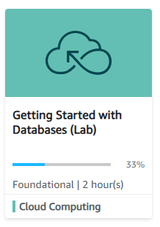
Hands-on Labs
AWS Educate Labs
1
Getting Started with Databases
Link
Getting Started with Databases (instructure.com)
Lab duration
~ 1hour
Description
Traditionally, creating a database can be a complex process that requires either a
database administrator or a systems administrator. In the cloud, you can reduce
the number of steps that you take during this process by using Amazon Relational Database Service (Amazon RDS). In this lab, you learn how to use Amazon RDS to provision a MySQL database and perform a few basic administrative actions.

Slide 54
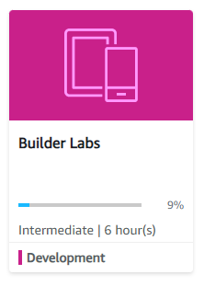
Hands-on Labs
AWS Educate Labs
2
Builder Labs: Adding Dynamic Data to Your Application with DynamoDB
Link
Builder Labs - DynamoDB lab
Lab duration
~ 45 min
Description
In this lab, you will learn how to create an Amazon DynamoDB table and use it to support and existing JavaScript application.

Slide 55
Thank you

